Slide 1

CREATING VALUE FROM BIG DATA: INTRO to Artificial Intelligence
Max Darby
DARBYM1@TCD.ie

Slide 2
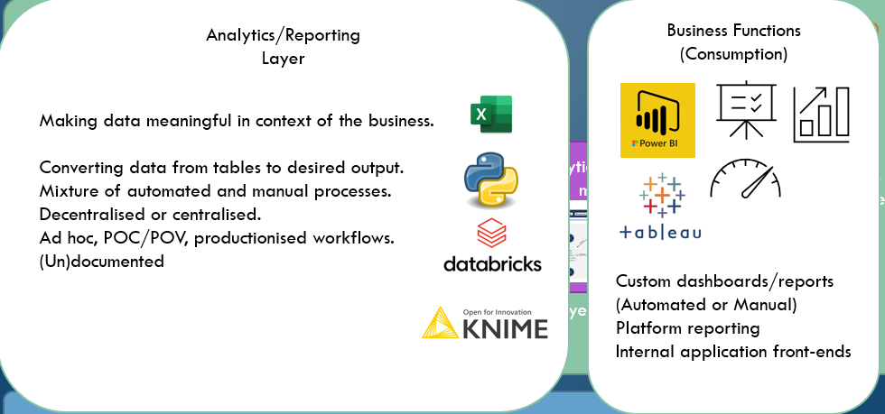
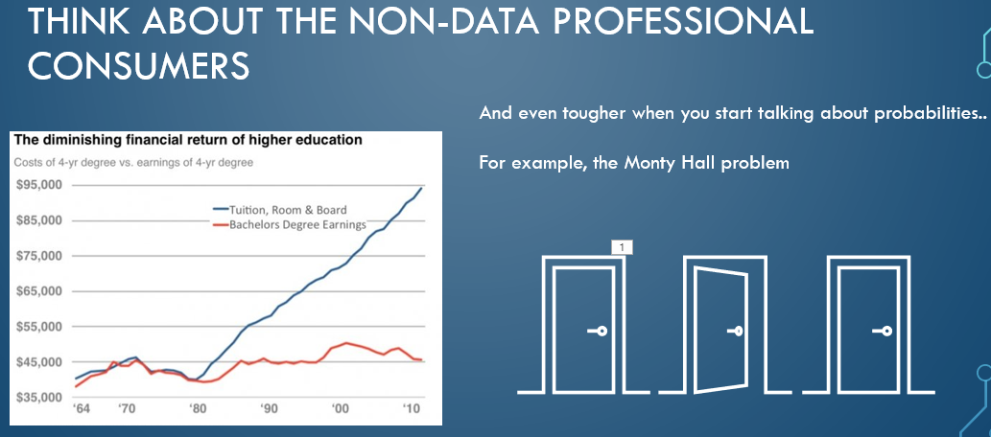
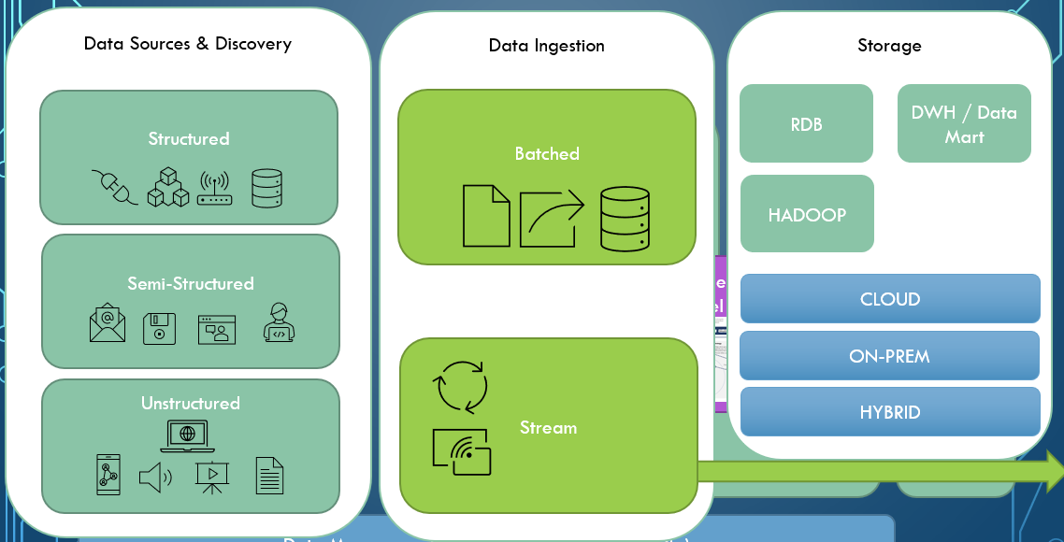
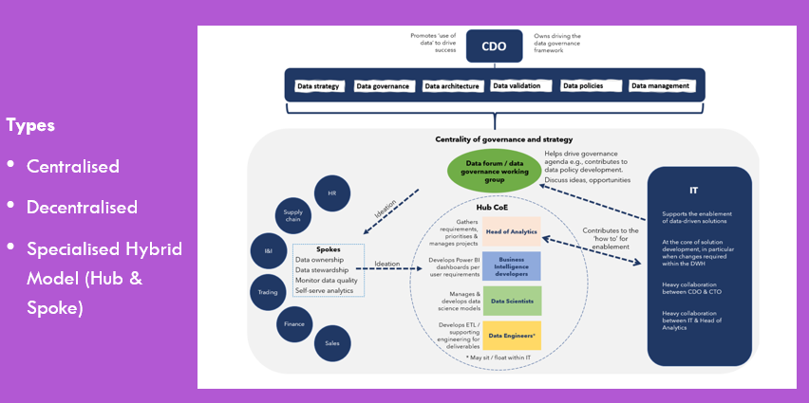
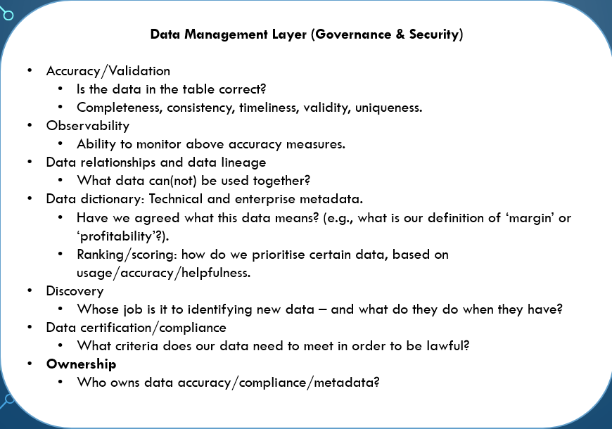
data strategy
Data Sources & Discovery
Data Ingestion
Storage
Analytics/Reporting
Layer
Business Functions (Consumption)
Business Objectives
Data Literacy
Analytic operating model
AI Layer
Data Management Layer (Governance & Security)
Notes:
Business goals/objectives – Decide whether Defensive | Offensive or mix.

Slide 3


Creating value from big data
Two options for generating value from Big Data

Slide 4

1st option:
Sell it.
Now it’s someone else’s problem
I don’t know, buy a yacht or something

Slide 5

2nd option
Use it
You fool, you should have just sold it
You could be on a yacht right now

Slide 6
Limitations of traditional analytical methods
The old adage: “You can’t manage what you can’t measure”
But what if measuring isn’t the point any more?
E.g., ‘check phone every 12 minutes’ misses all the valuable insight you would get from a day view or combining it with other data.
And that’s not even ‘Big’ data.
What would you do if you had phone-checking data streaming in constantly 24/7?

Slide 7
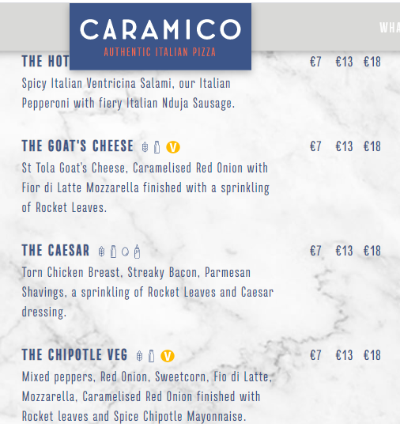
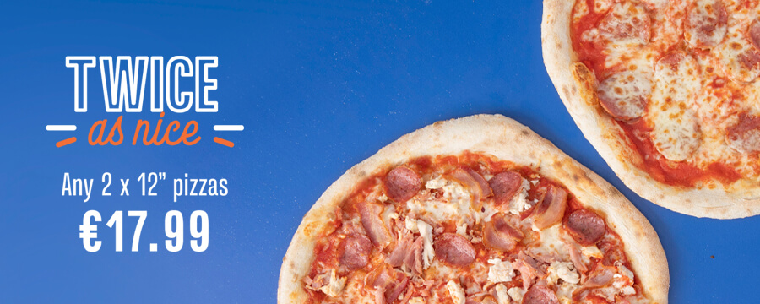
It’s Friday evening and you and your friend are getting a pizza. You both like the same toppings, and would be willing to share (as long as they strictly keep to their side, the chancers).
You’re exceptionally hungry, you just want as much pizza as you can get.
Your options are: get an 18 inch and share it, or they have a deal where you can get two 12 inch pizzas for the same price.
Before you can fully think it through you’re at the counter. You need to act soon. Your friend is becoming hangry, you don’t have much time. Which do you choose?

Slide 8
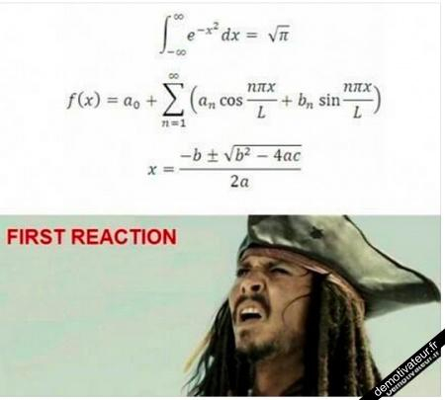
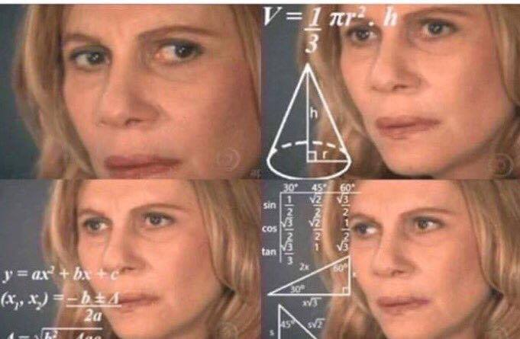

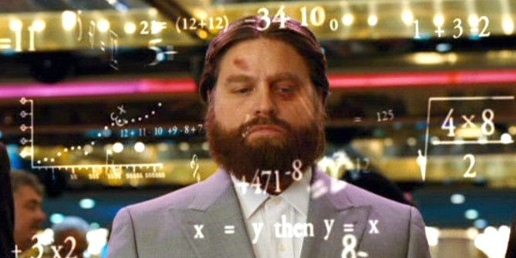
DATA
INFORMATION
KNOWLEDGE
WISDOM
18 or 2 x 12
A = πr2
254 square inches vs 2 x 113 square inches
One 18 inch has more pizza than two 12 inches combined
Orders 18 inch pizza

Slide 9
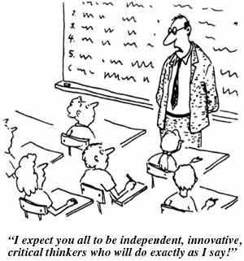
Two ways of implementing the analytics Stages:
DATA-Driven vs Data-Informed
Being data-informed helps you move from one stage of analysis to the next. Being data-driven skips straight from data to action (the middle bits done by a machine).
Knowledge, understanding, creativity
People
Statistically correct processes
Processes
Data-Informed:
“Too many companies think data should be their only guide and wind up over-optimizing small things rather than developing a bigger product vision”
“This means you can’t relegate all data-related tasks to a single product manager or data scientist. On the contrary, it makes it even more important that every member of your team be fluent with data”.

Slide 10
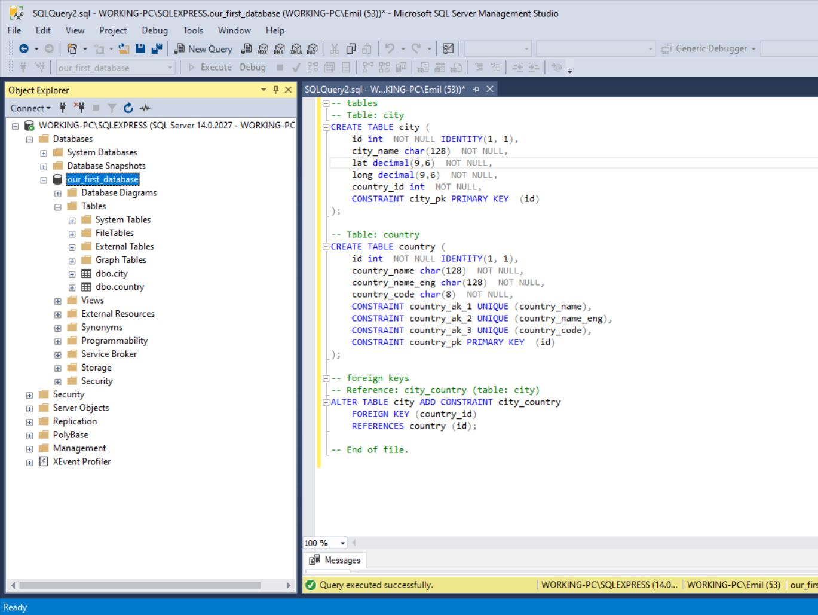
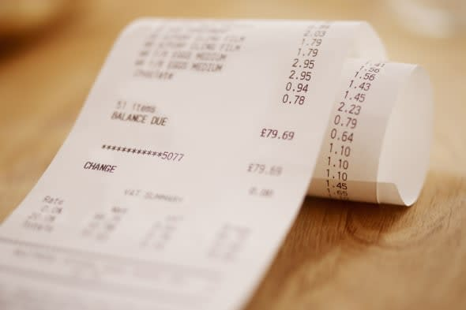
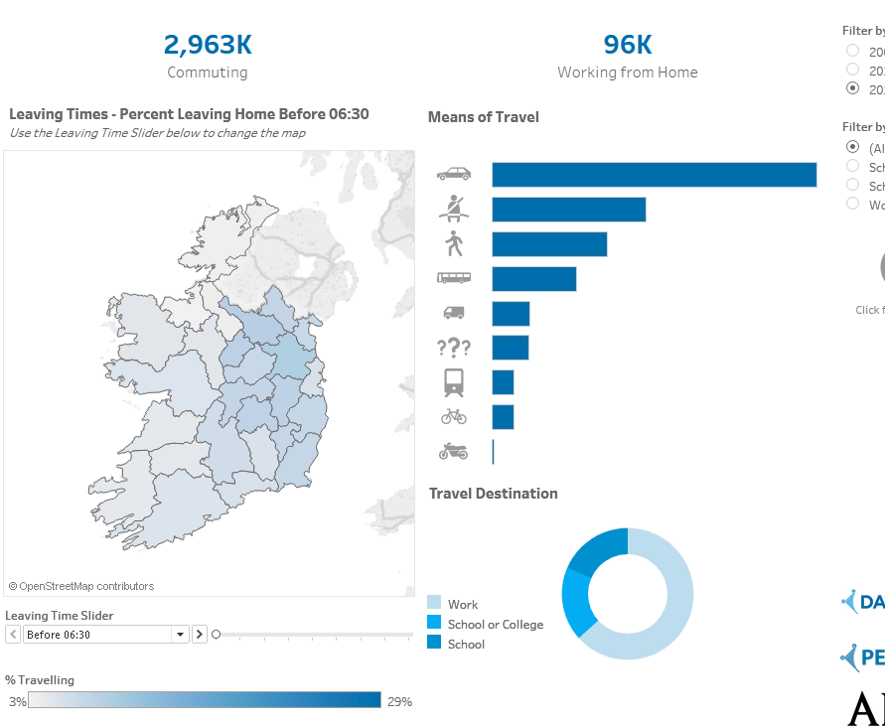
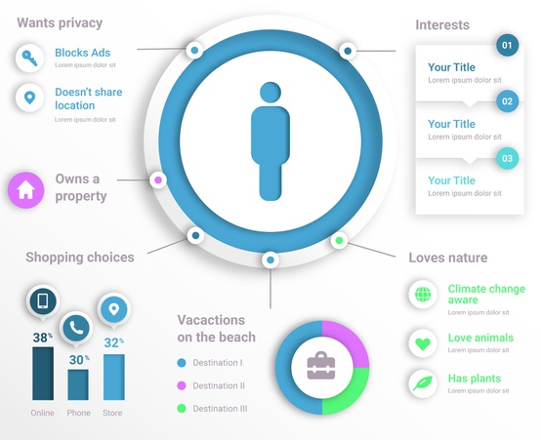
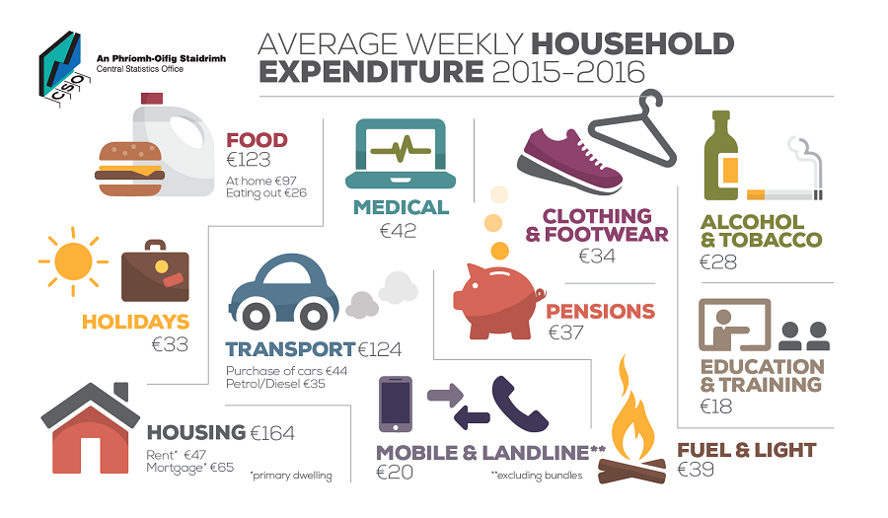
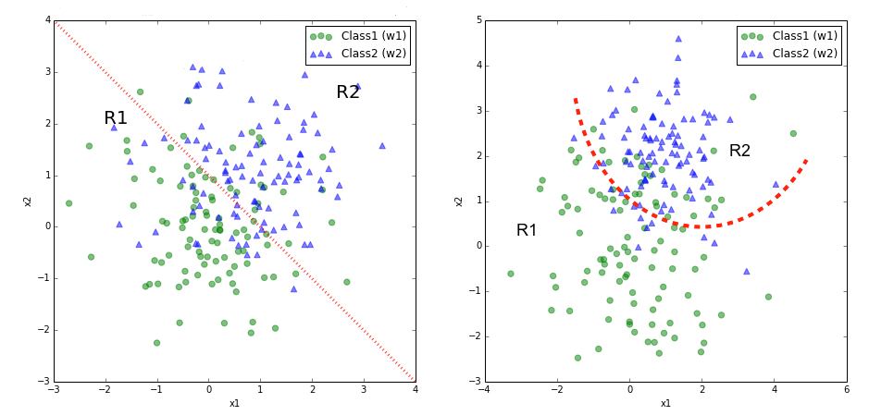

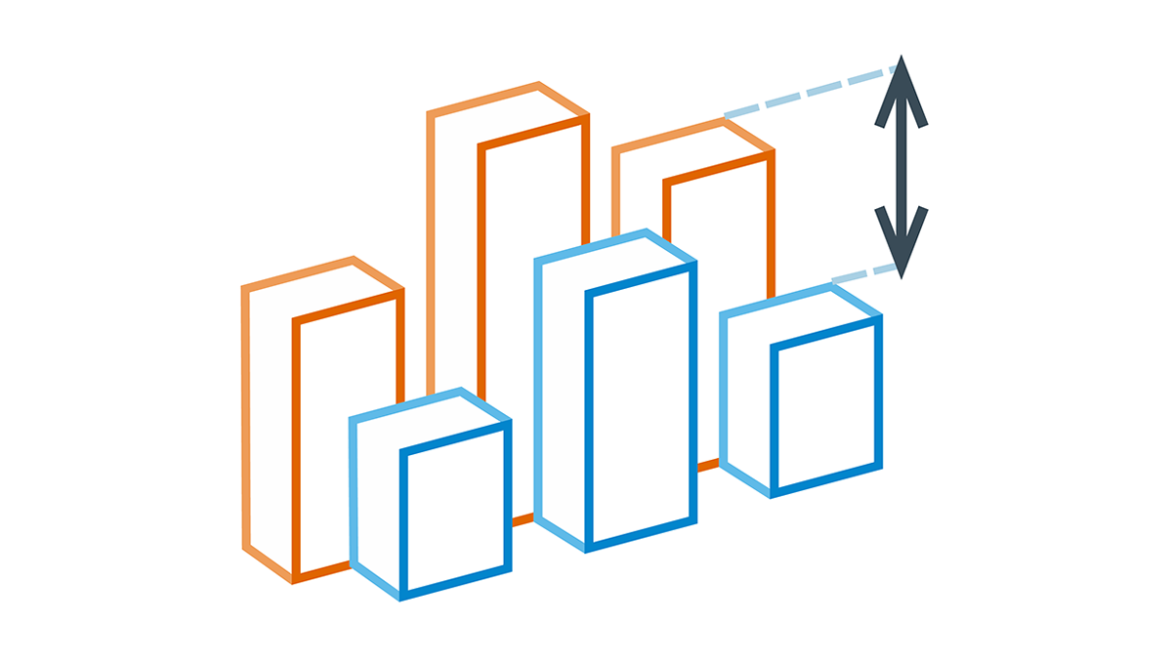

“We have a competitor opening 500 metres from the store and want to lessen the impact as much as we can”
DATA INFORMED – Varying success metrics, multiple ways of validating, local and business knowledge required
DATA
(RECORDS)
INFORMATION
(FACTS)
INSIGHT (KNOWLEDGE)
ACTION
(WISDOM)
We have data for:
Planning permission
Voucher usage
Customer locations
Demographics
Household spend
TNPS
We aggregate our data at a store and Small Area level.
Combine it with segmentation models, population sizes, traffic data, competitor sets, voucher history, transactional information, customer satisfaction scores.
We know that stores facing these competitors lose centre aisle spend and 2 types of customer – Stretched Families and YFM.
We know that these demographics make up a combined 45% of our store catchment, so are worth investing in to retain.
We know that these types of customers respond well to incentives (but they have to be 15% or more) and also have been complaining about the quality of parking in this SV store (2 sat scores lower than all other types).
We issue vouchers to Starter Families and YFM in the area – we track lost customers and put them into a hyper-care CRM programme.
We also do leaflet drops to these segment households where they aren’t RR customers.
We re-plan our carpark and repaint the lines. We make some spaces slightly wider for families and we install bike parking for the YF cyclists in the area.
We track performance vs what we expected. This becomes data for another future project.

Slide 11
DATA DRIVEN – Only one success metric and we optimise it
“I want to build an onboarding processes for ecommerce” i.e. minimise the likelihood they will stop shopping.
DATA
(RECORDS)
INFORMATION
(FACTS)
INSIGHT (KNOWLEDGE)
ACTION
(WISDOM)
Transactions
TNPS
We aggregate our data at a customer level.
Combine it with customer satisfaction scores.
We map poor customer experience against whether they shop again.
If a customer gets to 4 shops and has a poor experience, there is a 50 % chance they will shop again. If they get to 8 shops, there is a 90% chance they will shop again. This probability plateaus at 8 shops.
We keep a new customer in hyper-care until they get to their 8th shop.
Notes:
Insight (Knowledge) in italics – note how this is a ‘nice to know’ and a statement about data

Slide 12
Data-driven: a New paradigm, not just a buzzword
Analytical Process becomes experimentation
Once we trust a system to get us from Data to Action, then the process becomes more about a search for more/better/novel data. i.e., a move to understanding the performance of the model of thing, not the thing itself.
Shift in mindset & learning to balance exploration vs exploitation
Can really take industries by surprise.

Slide 13




Slide 14






Slide 15



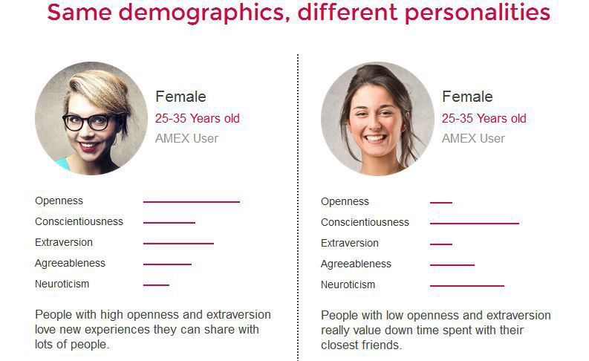
Trump campaign
“They were whispering bespoke messages in each voter’s ear instead of speaking openly in a town-square and letting people choose whether to listen”.
Notes:
“Mindf*ck” – Christopher Wylie

Slide 16
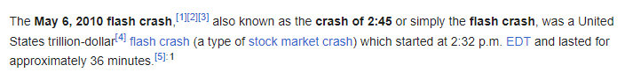
Data-driven
The peak of being data-driven is using AI.
Note: worth thinking about automated business decisions vs. automated physical processes – we’ll look at both, but it’s worth dwelling on the substantial difference between the benefits/risks each introduce.
Out of control warehouse vs out of control stock market

Slide 17
History of AI
Dartmouth
2 months summer 1956
Organised by John McCarthy, mathematics at Princeton, then Dartmouth.
Experience in psychology and ‘automata theory’ (later: computer science)
Coined the term ‘artificial intelligence’ to differentiate the vision from similar field ‘cybernetics’.
Topics to be discussed: natural-language processing, neural networks, machine learning, abstract concepts and reasoning, creativity.

Slide 18
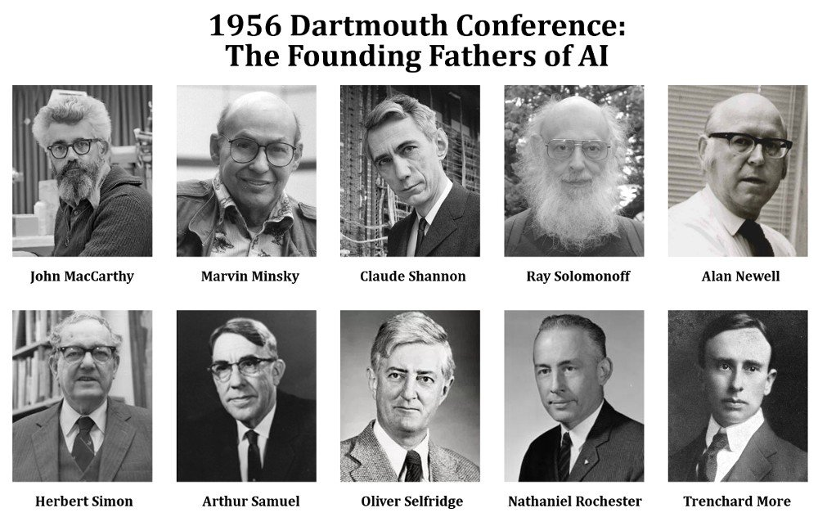
Founded AI labs
Minsky in MIT
McCarthy in Stanford
Simon and Newell in Carnegie Mellon
Rochester in IBM
“a significant advance can be made in one or more of these problems if a carefully selected group of scientists work on it together for a summer”

Slide 19
‘Anarchy of methods’
Mathematical logic & deductive reasoning (coding logical axioms)
Approach like the field of mathematics: if we can just distil and encode all the rules of the problems of intelligence, then eventually we’ll have a full picture of intelligence.
Inductive (statistics and probabilities)
Biology/psychology (brain architectures)
Can be broadly categorised into ‘symbolic’ and ‘sub-symbolic’ approaches

Slide 20


Symbolic
Sub-symbolic
Inspired by mathematical logic
Words and phrases (Symbols)
+ Rules
E.g., GPS (General Problem Solver)
Herbert Simon and Allen Newell
Mimicking thought processes
Current state and Desired state
Persisted for ~30 years – ‘expert systems’
Advantage for low memory/un-networked machines. Small datasets and only encoding the rules.
Inspired by neuroscience
‘capture the unconscious thought processes underlying what some have called fast perception, such as recognizing faces or identifying spoken words’ – Mitchel, p12
E.g., ‘perceptron’ (late 1950s)
Frank Rosenblatt (psychologist)
Later developed into deep neural networks
Minsky and Papert (Stanford colleague) wrote a book to critique – proposed the multi-layer solution which would lead to deep neural networks years later, but deterred anyone from working on/funding it through some negative speculation
Notes:
‘Artificial Intelligence: A Guide for Thinking Humans’ – Melanie Mitchel

Slide 21

Ai winter
Up until mid-1970s: had been driving ahead with symbolic and ‘expert’ systems
IBM even shutdown their AI lab out of fears of automation
“Computers can only do what they are programmed to do” – reinforced the idea of structural programming as the only paradigm.
Promised breakthroughs had not materialised

Slide 22
Brief AI SUMMER
Small AI summer in the 80s, but was short-lived (partly due to oil crisis but mostly just technology not quite there yet).
‘When I got out of graduate school in 1990, the field was in one of its winters and had garnered such a bad image that I was even advised to leave the term ‘artificial intelligence’ off my job applications’ p.26

Slide 23

where are we now?
Notes:
Humans Need Not Apply – Jerry Kaplan

Slide 24
“The question of whether machines can think is about as relevant as the question of whether submarines can swim” – Edsger Dijkstra
Bit more fragmented – people aren’t working on general AGI architectures anymore, they are working on specific problems with purpose-built systems (mostly because AI is commercially funded rather than research/state funded now – developments are aligned with commercial goals and targets are more narrow and well-defined).
More brute-brute force than elegant/reductive algorithms that capture the essence of general intelligence
E.g., Transformer based neural net GPT-3 still needs 45TB of data.
Two systems where AI is being built:
KNOWLEDGE: Synthetic intellects: all about knowing everything (huge data sets, different types of data from the web and computer networks)
ROBOTS: ‘Forged laborers’ (Kaplan) or Disembodied AI: more like ‘smart environments’. Sensors and actuators everywhere (actuator could be you – e.g., driving with Google Maps).
Notes:
Humans Need Not Apply – Jerry Kaplan

